Slide 1


Creative Dynamic Virtual Systems, Inc.
"Virtual Precision. Dynamic Vitality."
CDVS©

Slide 2
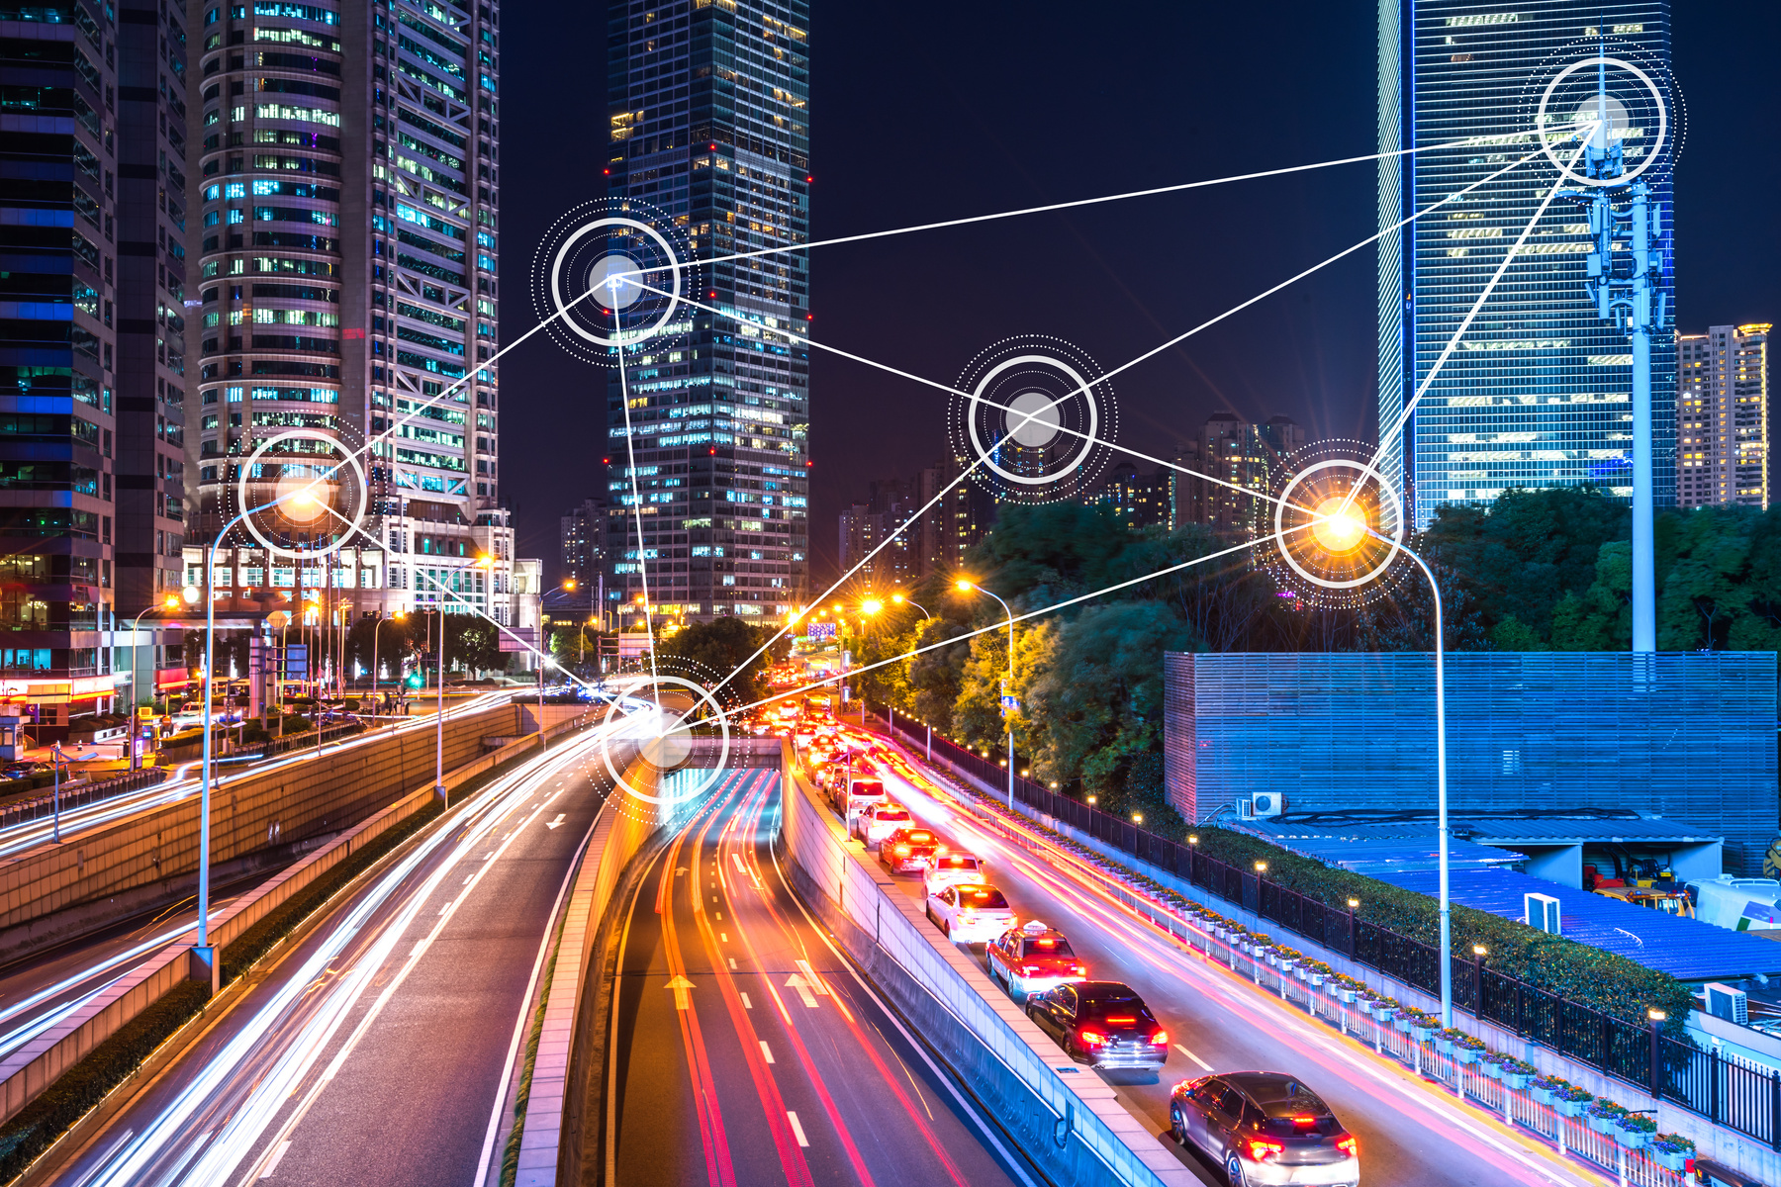
THE CDVS ADVANTAGE
CDVS is not just building a product; we are building the Cognitive OS for Regenerative Medicine. Our proprietary SNN is the only architecture designed specifically to handle the "Fourth Dimension" (Time) in biological manufacturing, powered by the only hardware capable of processing it (IBM Z).
Introduction to AI and its
Transformative Potential
01
02
Automation
Efficiency
The Bioprinting Landscape (2026)
Headline: Moving from Static Scaffolds to Dynamic Life
The Status Quo (3D): A $2.7B market dominated by static, inert replicas. These structures cannot adapt to the patient's body post-surgery.
03
04
Personalization
Innovation
The Frontier (4D): A rapidly emerging sector (34% CAGR) focused on "Smart Materials" that morph and self-repair.
The CDVS Position: We occupy the intersection of 4D Materials and Ensemble AI, a space currently unoccupied by legacy 3D hardware vendors.

Slide 3



AI in Product
Automated Design
Development and Design
AI algorithms can generate design concepts based on specific requirements and constraints, speeding up the design process.
Materials Optimization
The CDVS Unfair Advantage (The "SNN Brain") Headline:
Why IBM z17 is our Competitive Moat
Real-Time Correction: While competitors' prints fail if a single cell layer drifts, our SNN (powered by Spyre) corrects the path in <1ms.
The "Gesture Lexicon": Our partnership with BMW Designworks creates a proprietary HMI that legacy firms cannot replicate without years of UX research.
Space-to-Earth Pipeline: By using Redwire Space heritage and NASA Laser Comms, we bypass the manufacturing limitations of Earth’s gravity, which our competitors are still battling.
AI can analyze material properties and predict performance, leading to the selection of optimal materials for product design.
Manufacturing Automation
AI-powered robots and automated systems are transforming manufacturing processes, increasing efficiency and precision.

Slide 4
The Bioprinting Landscape (2026)
and Customization
The Bioprinting Landscape (2026)
Headline: Moving from Static Scaffolds to Dynamic Life
The Status Quo (3D): A $2.7B market dominated by static, inert replicas. These structures cannot adapt to the patient's body post-surgery.
The Frontier (4D): A rapidly emerging sector (34% CAGR) focused on "Smart Materials" that morph and self-repair.
The CDVS Position: We occupy the intersection of 4D Materials and Ensemble AI, a space currently unoccupied by legacy 3D hardware vendors.
Recommenda-tion Engines
Customizable Products
Personalized Marketing
This Competitive Analysis is structured presentation. It highlights the "Strategic Gap" in the current market: while legacy players excel at static 3D structures.
Standard Embedded Controllers
IBM z17 Spyre / Power10
Decision Logic
Linear / Manual Calibration
Local LAN / Physical Drives
NASA Laser (LCRD) / Orbital
Stacked Neural Network (SNN)
Surgical Interface
2D Screen / Manual Joysticks
Holographic Gesture (BMW HMI)
Data Link

Slide 5

AI and the Future of
AI is transforming the customer experience by providing personalized interactions, instant support, and seamless service.
Customer Experience
01
Personalized Interactions
AI chatbots and virtual assistants provide personalized interactions, answering questions and resolving issues efficiently.
02
Predictive Maintenance
AI can predict potential issues with products and services, enabling proactive support and minimizing downtime.
03
Sentiment Analysis
AI analyzes customer feedback and sentiment, providing insights into customer satisfaction and areas for improvement.

Slide 6



Leveraging AI for
Predictive Analytics and Decision-Making
AI-powered predictive analytics provide insights into future trends and patterns, enabling better decision-making across various industries.
Finance
Healthcare
Retail
Fraud detection, risk assessment, and investment analysis
Disease prediction, personalized treatment plans, and drug discovery
Demand forecasting, inventory management, and customer segmentation

Slide 7
AI and the Workforce:
Augmenting Human Capabilities
AI is not replacing humans but rather augmenting human capabilities, enhancing productivity and enabling workers to focus on more creative and strategic tasks.
Task Automation
Enhanced Decision-Making
Improved Efficiency
AI automates routine tasks, freeing up human workers for more complex and meaningful work.
AI provides insights and recommendations, enabling humans to make more informed and effective decisions.
AI optimizes workflows, reduces errors, and improves overall efficiency, leading to better outcomes.

Slide 8

Ethical Considerations
As AI becomes more prevalent, it's crucial to consider ethical implications and ensure responsible deployment to avoid potential risks.
and Responsible AI Deployment
01
Data Privacy
02
Bias and Fairness
Protecting user data and ensuring responsible use of personal information is essential.
AI algorithms should be fair and unbiased, avoiding discrimination or perpetuating existing inequalities.
03
Transparency and Explainability
04
Security and Safety
AI decisions should be transparent and explainable, allowing users to understand how they were made.
AI systems should be secure and safe, preventing malicious attacks or unintended consequences.

Slide 9




Challenges
Data Quality and Availability
and Barriers to AI Adoption
AI requires vast amounts of high-quality data for training and development, which can be a significant barrier.
Talent Shortage
A shortage of skilled AI professionals can hinder the development and deployment of AI solutions.
Despite its potential, AI adoption faces challenges, such as data availability, talent shortage, and ethical concerns.
Ethical Concerns
Concerns about bias, transparency, and safety can limit the adoption of AI in certain sectors.
Cost and Complexity
Developing and deploying AI solutions can be costly and complex, requiring significant investment.

Slide 10
The Road Ahead:
AI-Powered Innovation Trends and Predictions
AI is poised to continue transforming our world, with exciting trends and predictions shaping the future of innovation.
Smart Cities
Precision Healthcare
Autonomous Vehicles
AI will power smart cities, optimizing transportation, energy consumption, and resource management.
AI will revolutionize healthcare, enabling personalized medicine, early disease detection, and efficient drug discovery.
AI will drive the development of autonomous vehicles, improving safety, efficiency, and accessibility of transportation.

