Slide 1
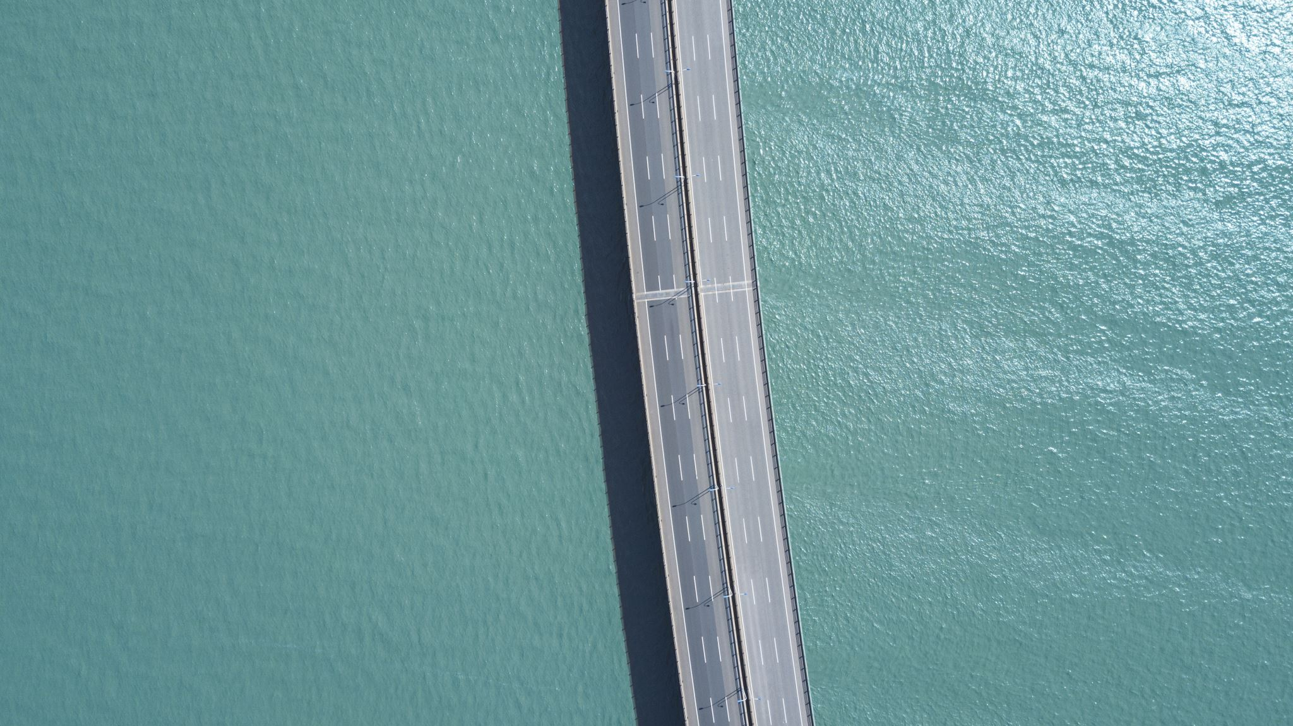
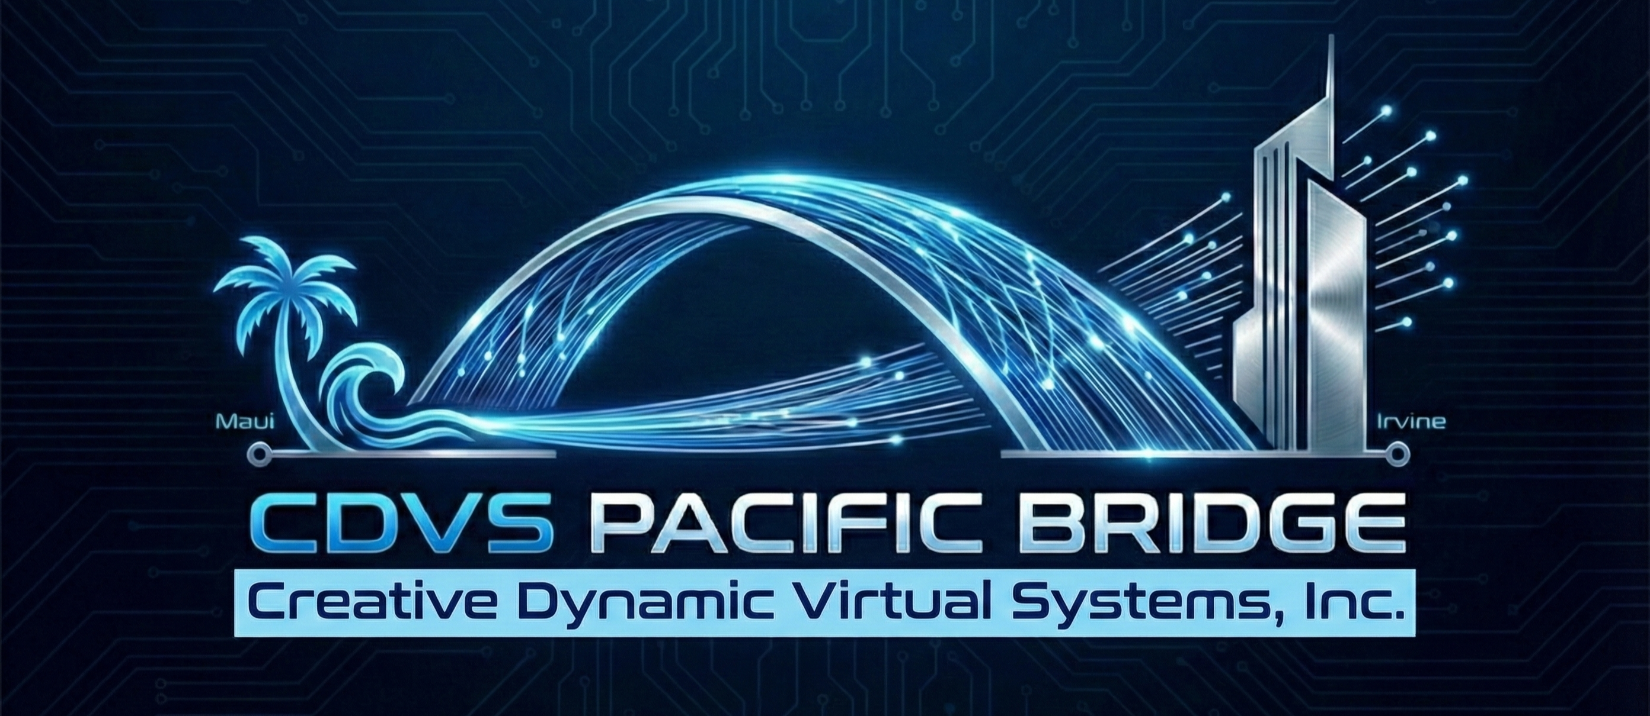
Project HELIOS & The Pacific Bridge Project
Creative Dynamic Virtual Systems, Inc. (CDVS)
Kevin R. Turner | Founder, Chairman, President & COO
Virtual Precision. Dynamic Vitality.

Slide 2
Executive Summary
• The Innovation: Project HELIOS—a leap forward in glasses-free holographic surgical design and advanced bioprinting.
• The Foundation: The "Pacific Bridge"—a strategic dual-location corporate expansion to drive R&D and global operations.
• The Security: Uncompromising data integrity powered by our proprietary Neural-Ledger blockchain and enterprise-grade hardware.

Slide 3
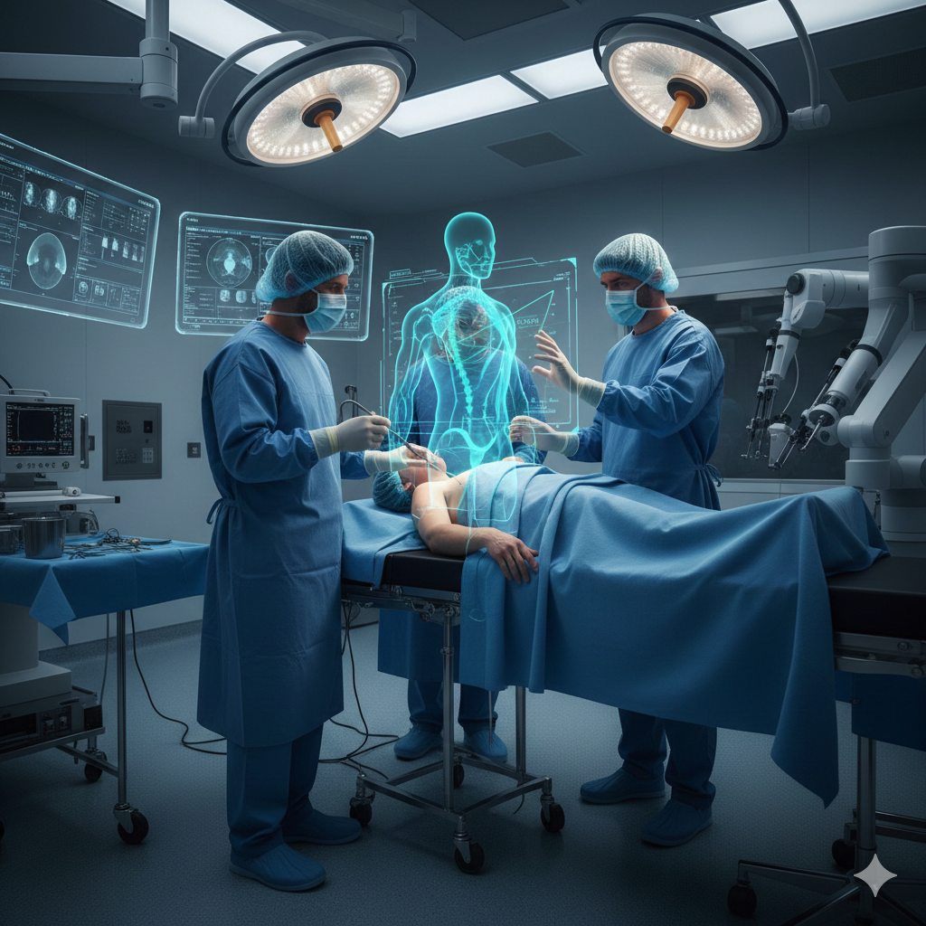
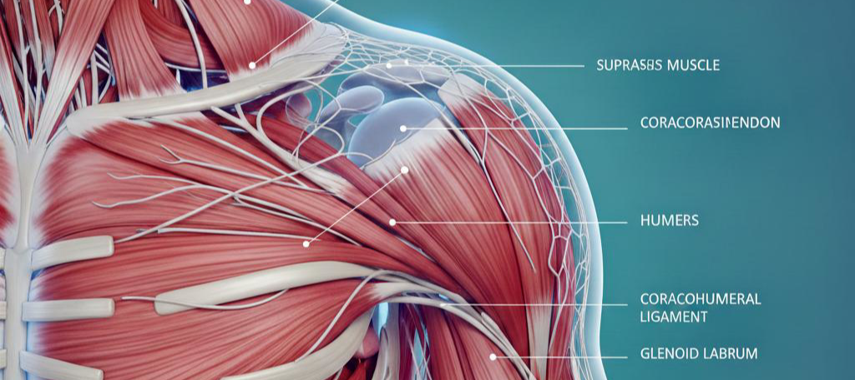
Strategic Dual-Location Synergy
• Corporate Headquarters: Irvine, California. Serving as the central command for business operations and strategic partnerships.
• Secondary R&D Hub: Maui, Hawaii. A dedicated facility focused on continuous innovation and technology refinement.

Slide 4
Unprecedented Computing Power & Security
• Hardware: Utilizing the IBM z17 mainframe coupled with AT&T networking equipment for maximum processing capability.
• Housing: Hosted within a highly secure DataBank facility.
• Security: The "Neural-Ledger"—our immutable blockchain audit trail ensuring absolute data protection for sensitive medical models.

Slide 5

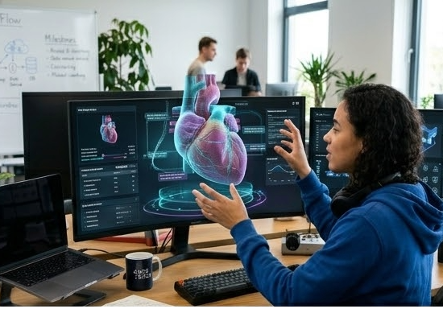
Project HELIOS: The Future of Surgical Precision
The core initiative of CDVS, designed to revolutionize surgical planning and execution.
Powered by our proprietary stacked neural networks to process vast amounts of complex medical data in real-time.

Slide 6
Unrestricted 3D Visualization
• True glasses-free holographic interfaces.
• Allows surgical teams to interact with high-fidelity, patient-specific models without the hindrance of VR/AR headsets.
• Enhances pre-operative planning, reducing surgical risk and improving patient outcomes.

Slide 7
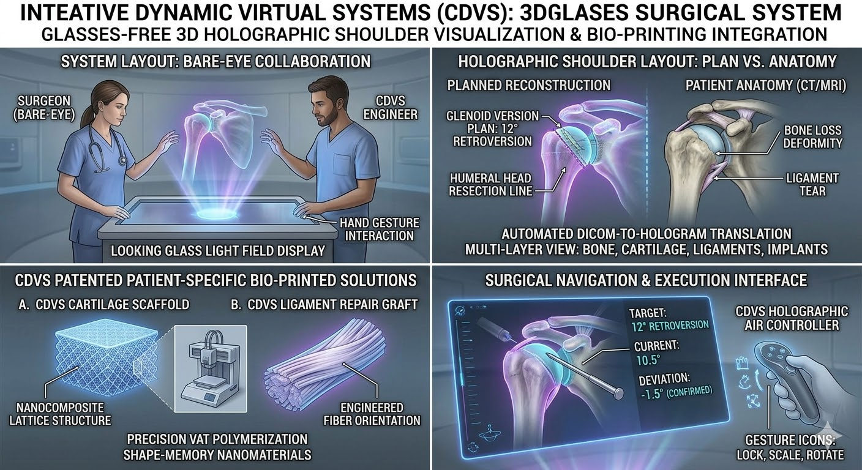
3D/4D Bioprinting in Low Earth Orbit (LEO)
• Utilizing "Bouncy Bio-Glass" materials to engineer complex tissue structures.
• Leveraging the microgravity environment of LEO to manufacture bio-structures that would collapse under Earth's gravity.
• Seamlessly integrated with HELIOS holographic models for precise structural design.

Slide 8
The Team Driving the Vision
• Kevin R. Turner: Driving overall corporate strategy and technological architecture.
• Corazon M. Macario: Executive Vice President & Head of SE Asia Liaison, expanding our global operational reach.
• Dylan Chang: Executive Director of Logistics, ensuring seamless integration across the Pacific Bridge.

Slide 9
Capitalizing the Vision
• Actively pursuing strategic grants from the State of California, the City of Irvine, and targeted federal programs.
• Establishing the Irvine HQ infrastructure as the immediate priority.
• Initiating preliminary R&D staging for the Maui facility.

Slide 10

Conclusion & Questions
• Virtual Precision. Dynamic Vitality.
• Floor open for questions regarding technology, infrastructure, or strategic partnerships.
• CDVS Contact Information

